Slide 1
John 9 Rod Thom
“Blindman Healed”

Slide 2
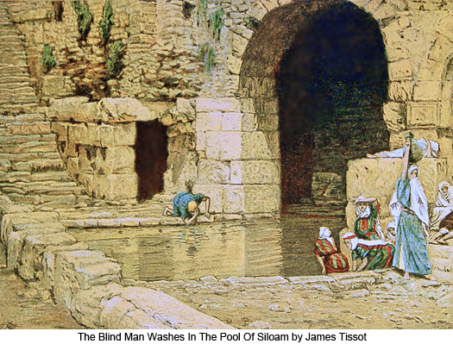
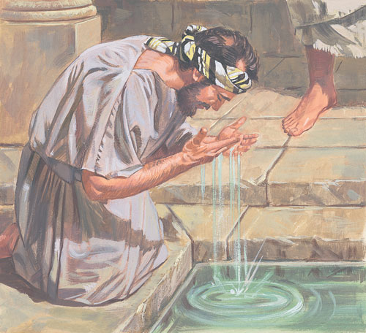
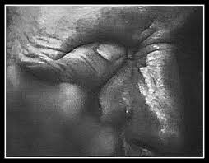
Blindman Healed

Slide 3
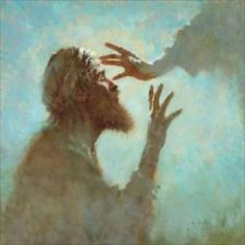
Blindman Healed
V11, A man they call Jesus?

Slide 4
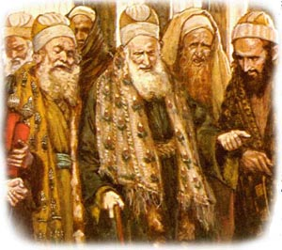
Blindman Healed

Slide 5
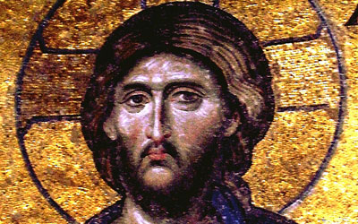
Blindman Healed
V17, A Prophet?

Slide 6
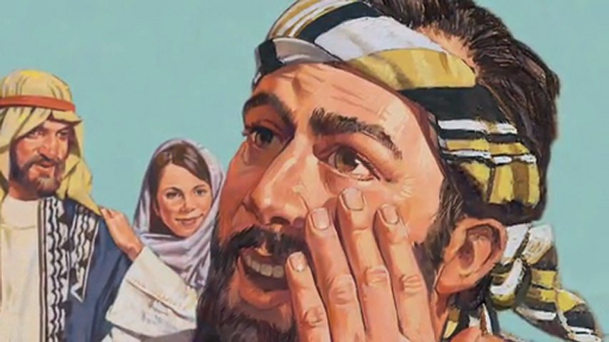
Blindman Healed

Slide 7
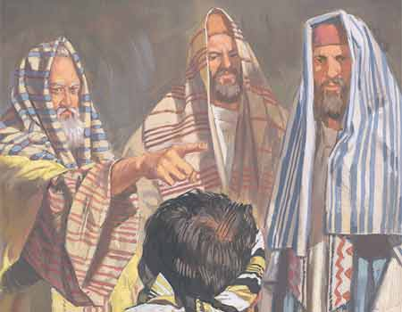
Blindman Healed
V 32-33, He must be from God?

Slide 8
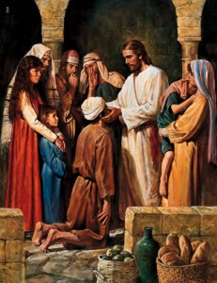
Blindman Healed
V 38, Lord!

Slide 9
Blindman Healed
V11- A bloke called Jesus?
V17- A Prophet?
V32-33- He must be from God?
V35-36 Jesus challenges HIM, Do you believe in the son of Man?
V38- LORD I believe!

Slide 10
Blindman Healed
What do you Believe?

